Slide 1
Inception ResNet v2
By Khannanova Aigul, Khammatov Karim
Kazan, 2018

Slide 2
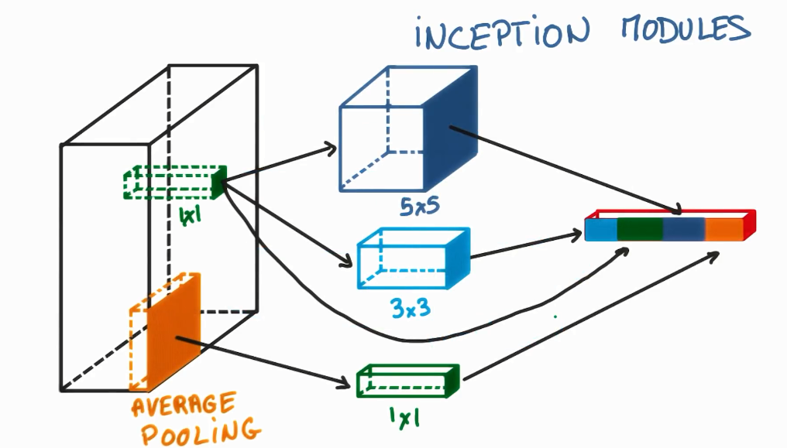
Inception modules

Slide 3
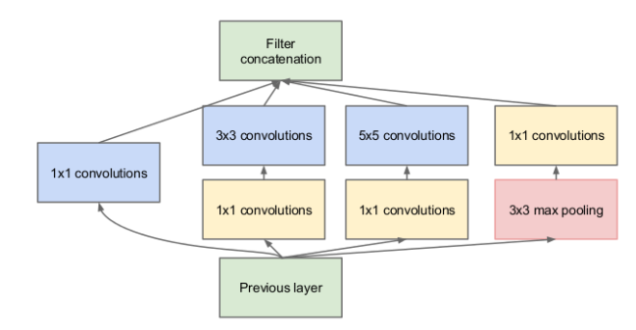
Full inception module

Slide 4
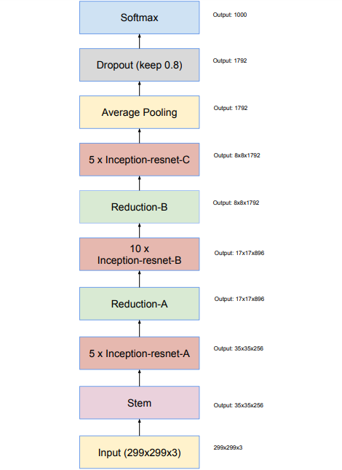
Schema for Inception-ResNet-v1 and InceptionResNet-v2 networks

Slide 5
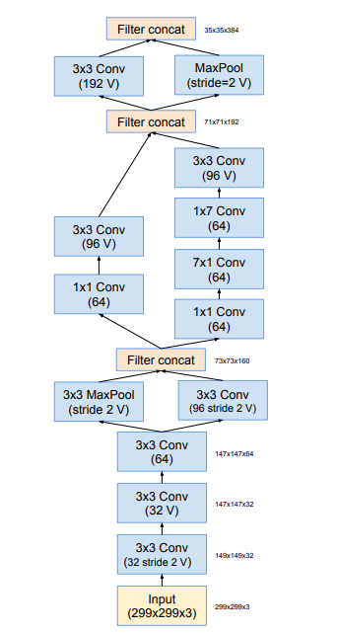
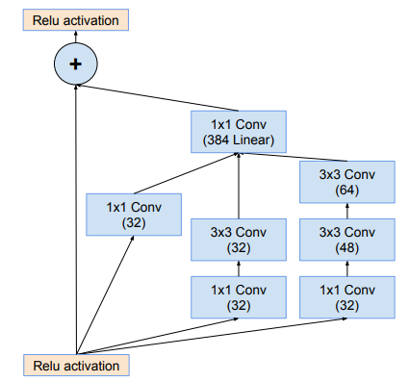
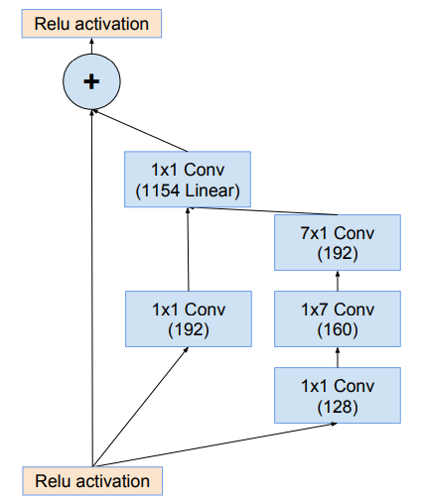
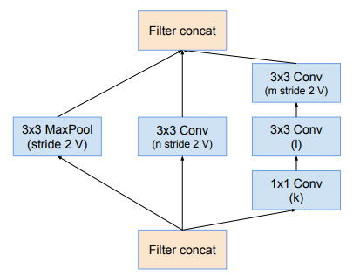
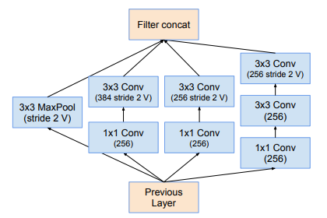
1. The schema for stem of the pure Inception-v4 and Inception-ResNet-v2 networks
2. The schema for 35 × 35 grid (Inception-ResNet-A)
4. The schema for 17 × 17 grid (Inception-ResNet-B)
3. The schema for 35 × 35 to 17 × 17 – Reduction A.
5. “Reduction-B” - 17×17 to 8×8 grid-reduction module

Slide 6
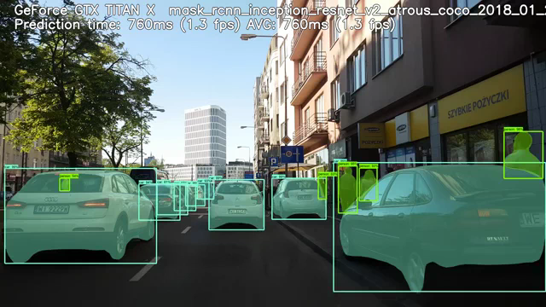
Mask RCNN Inception Resnet v2 Atrous from Tensorflow Models

Slide 7
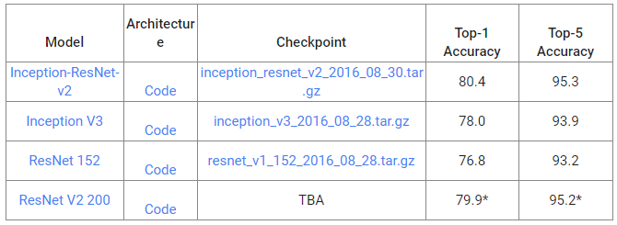
Advantages/disadvantages
If the number of filters exceeded 1000, the residual variants started to exhibit instabilities and the network has just “died” early in the training

